Slide 1
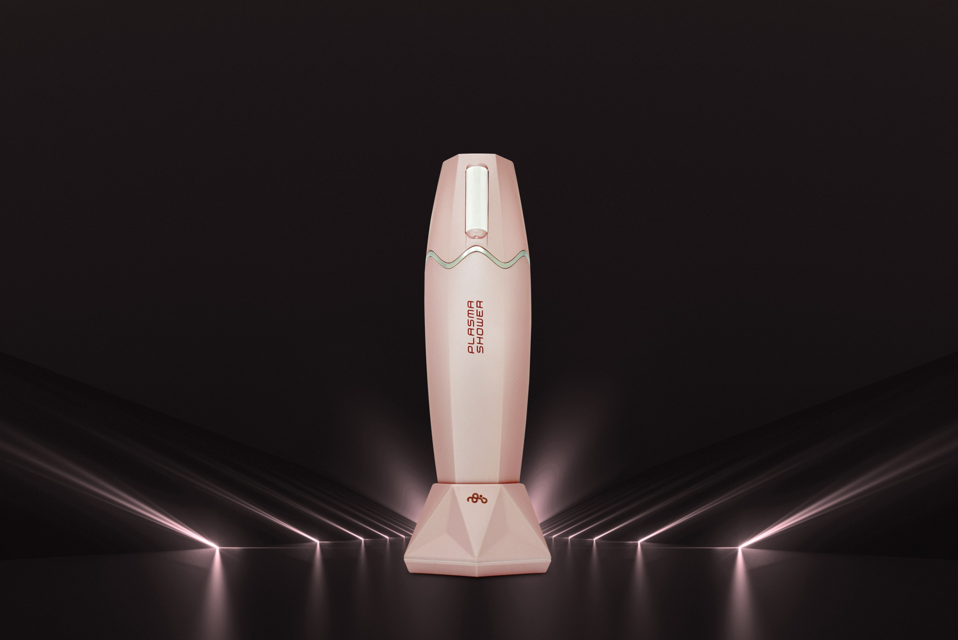
Shower your skin with next generation
Plasma Technology.

Slide 2
Contents
1. What is Plasma?
the science and the application
2. Plasma shower
the properties and the strength
3. How to Plasma shower
the ways and means to Plasma shower
4. Treatment Data
the evidence of effectiveness
5. Clinical Results
the evidence of effectiveness

Slide 3
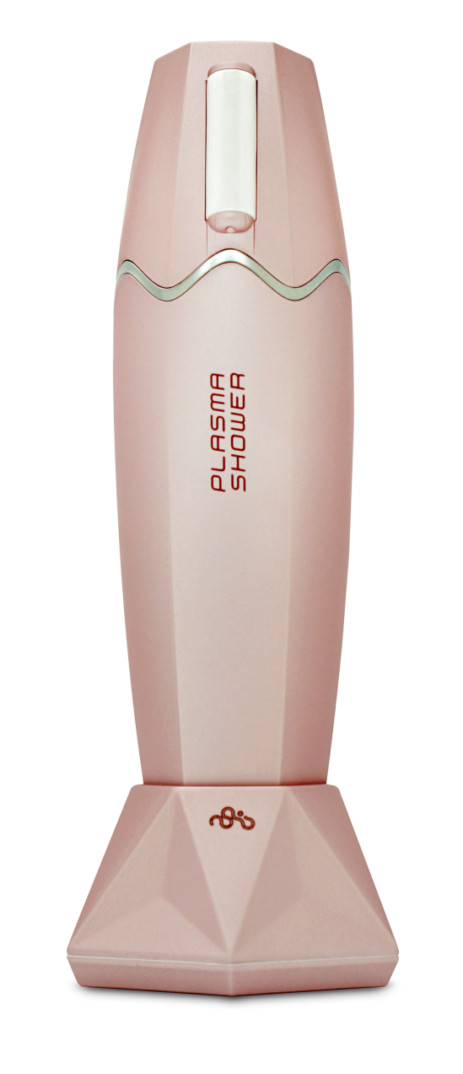
What is Plasma?
the science and the application

Slide 4
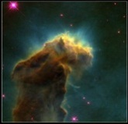
01_ What is Plasma?
• Plasma is the fourth state of matter following the state of solid, liquid and gas whereby the gaseous
state has been ionized by the high temperature and high electricity in everyday environment
• The universe is consisted of 99.999% plasma

Slide 5
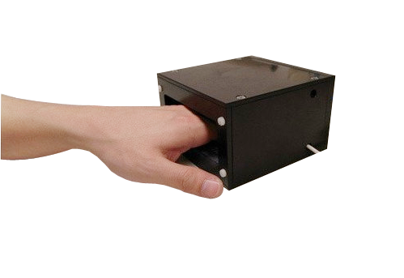
01_ What is Plasma?
• History of plasma in medical application
The use of plasma in medical field goes back as far as World War II to sterilize the wound and surgical equipment.
According to the latest cell biological research conducted by Munich University, plasma works separately in bacteria and human cell and while it is fatal to bacteria, it provides beneficial stimulation to human cell and helps with regeneration.
Plasma is becoming increasingly used as
the next generation medical/aesthetic technology

Slide 6
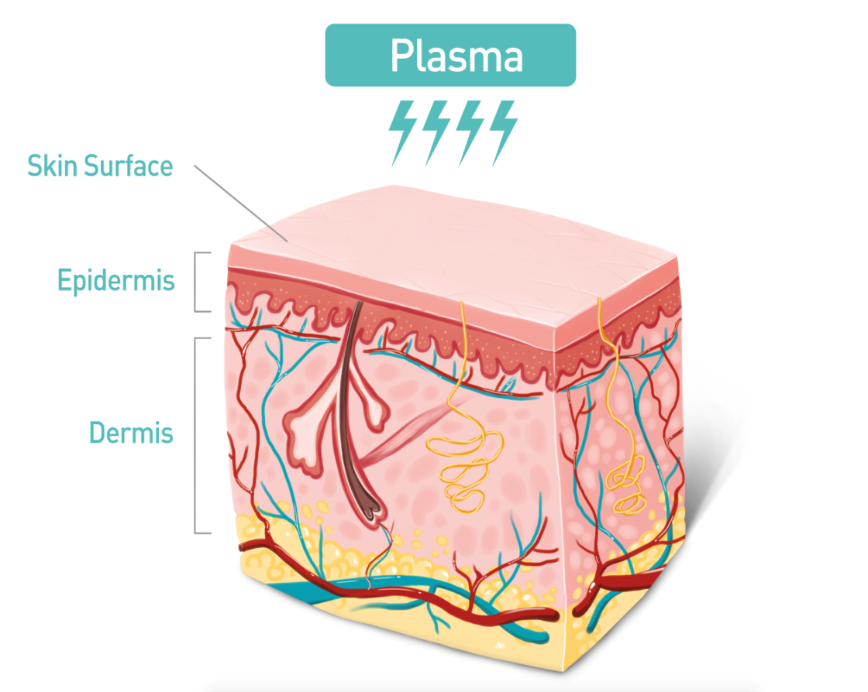
01_ What is Plasma?
•The effect of plasma on human skin
Intensity of electrical energy (weakens with the flow)
1
Kills the germs and bacteria by breaking the bacterial
molecular structure
2
Dramatically increase the skin absorption rate by temporarily breaking the cell adhesion molecules (CAMs)
3
Tightens the aged skin by balancing the membrane potential
4
Stimulates the generation of collagen and fibroblasts by stimulating the circulation of water molecules and increasing the heat and friction

Slide 7
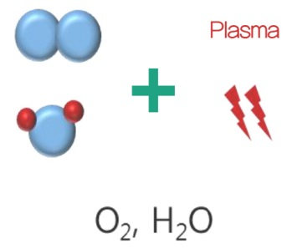
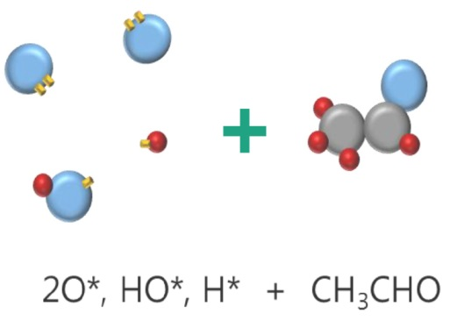
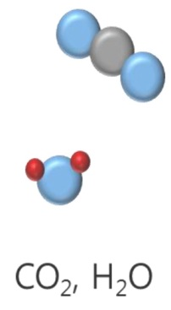
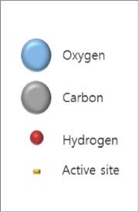
01_ What is Plasma?
•Sterilization Mechanism by Plasma Radicals (e.g.: CH3CHO)
1
2
3
Exerting high atmospheric pressure
Radicals trying to stabilize
Sterilization
Exerting high heat or pressure in atmosphere creates plasma radicals with broken molecular structure
The plasma radicals in broken molecular structure are in unstable state, and work to stabilize by combining with bacterial molecules
The plasma radicals combined with bacterial molecules break the bacterial molecules and turn them into molecules such as carbon dioxide and water, thereby causing effective sterilization effect

Slide 8
01_ What is Plasma?
•Increasing Skin Elasticity through “F-DBD” Plasma
Plasma Induction
01. Aged Cell
02. Plasma Induced Cell
The cells have membrane potential with the inner membrane negatively charged while the outer membrane positively charged. As the skin gets aged, the charge gets maldistributed along the membrane which changes the electrical voltage of the membrane.
The membrane potential is affected by the potassium and sodium ion and while the potassium passes through easily, it is difficult for sodium to pass through. “F-DBD” Plasma changes the membrane potential and enables all types of ion to easily pass through the membrane and balance the potential thereby tightening the membrane
(Can see the elasticity of skin through naked eye).
F-DBD (Floating Dielectric Barrier Discharge) is exclusive technology of Seoulin Medicare and it does not require any grounding.

Slide 9
PLASMA SHOWER
the properties and the strength

Slide 10
02_ Plasma shower
PLASMA SHOWER
Plasma shower removes the bacteria and helps absorb essential drug to the skin tissue. A strong low-temperature atmospheric plasma on the surface of the skin sterilize the skin and the ionized radicals stimulates the skin treatment process such as skin regeneration,
anti-bacteria, TDDS (Transdermal Drug Delivery System), skin whitening and collagen generation.
TDDS
Toning Effect
Sterilization
Skin Regeneration
Inducing amazing absorption by breaking the Cell Adhesion Molecules(CAMs) that connect the skin cell
Anti-pigmentation effect through suppressing melanin pigment and strengthening the absorption of anti-pigmentation cosmetics
Sterilize bacteria which cause various skin problems with powerful sterilization power
Preventing skin aging by stimulating generation of collagen and fibroblasts

Slide 11
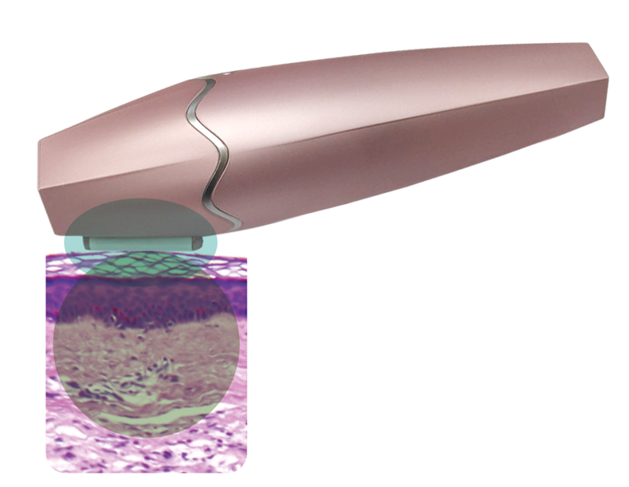
02_ Plasma shower
• Plasma Shower Operation Principle
1
Creating plasma by applying high-frequency,
high-pressure in atmosphere
2
Delivering stable plasma ion to the tip of the handpiece
Plasma
Biochemical molecule
radicals
(Stimulating biochemical process)
3
Stable and effective skin treatment mechanism by stimulating biochemical process in inner and outer area of biological cell

Slide 12
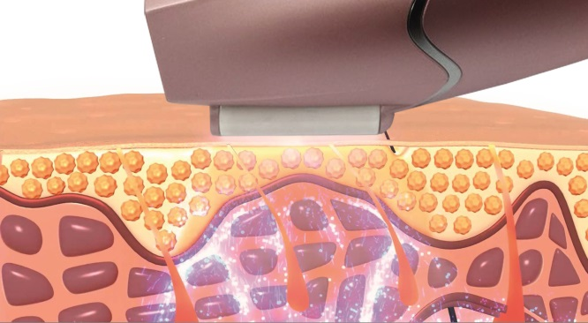
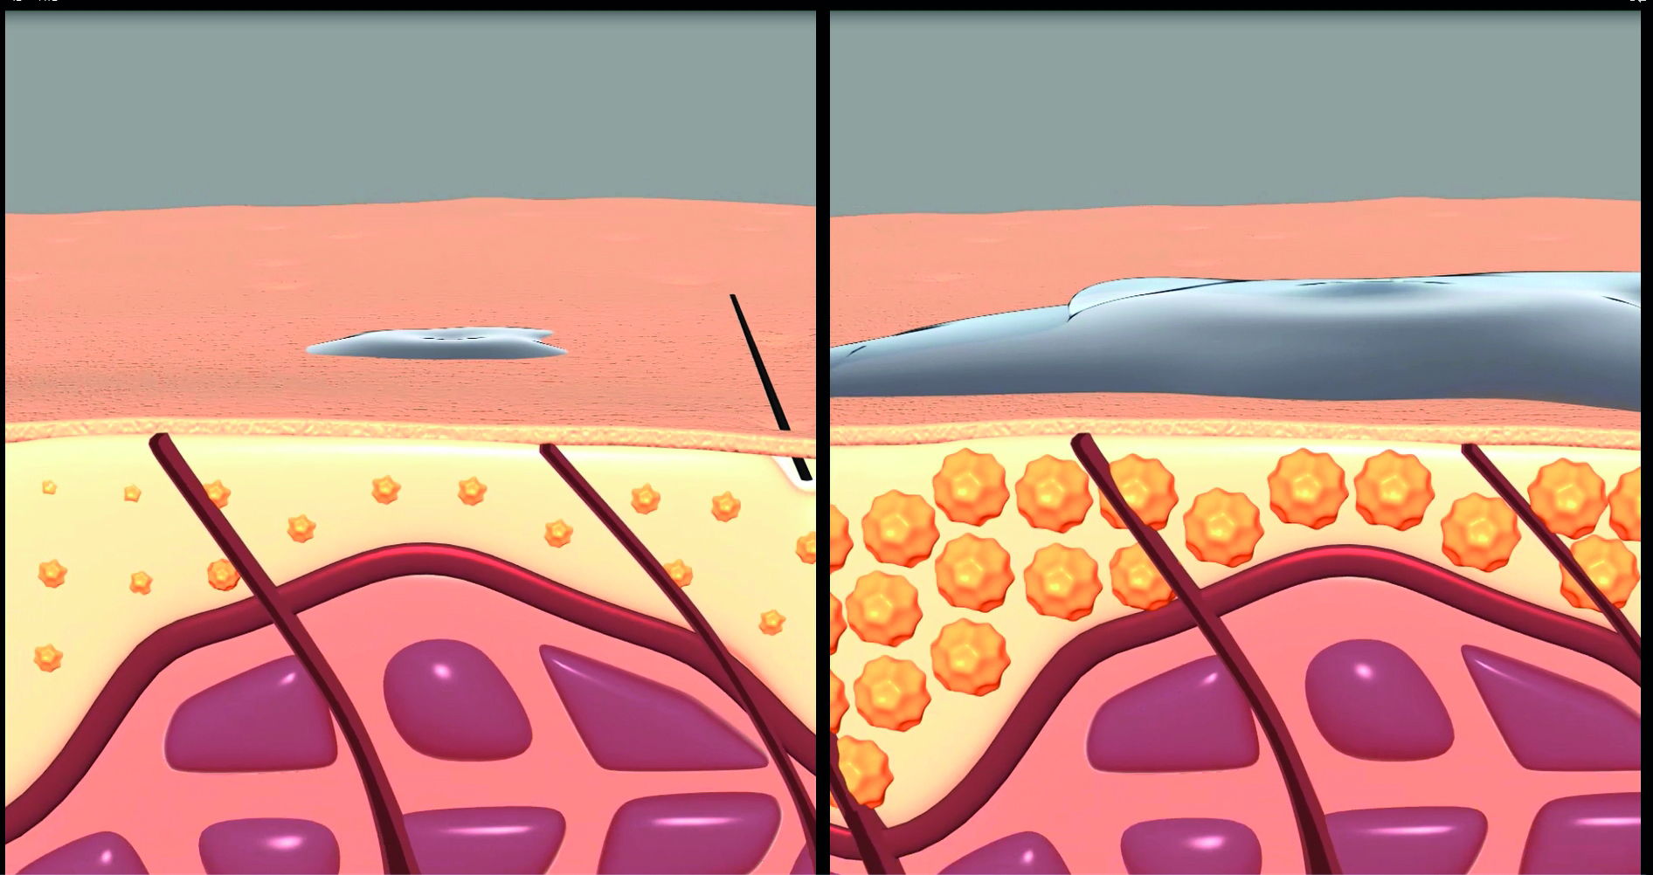
02_ Plasma shower
•TDDS (Transdermal Drug Delivery System)
TDDS
Inducing amazing absorption by breaking the Cell Adhesion Molecules(CAMs) that connect the skin cell
Plasma Treated
Plasma Untreated
Drug Delivery ↑
No Drug Delivery
Breaking Cell Adhesion Molecules(CAMs) temporarily
and dramatically increasing drug delivery

Slide 13
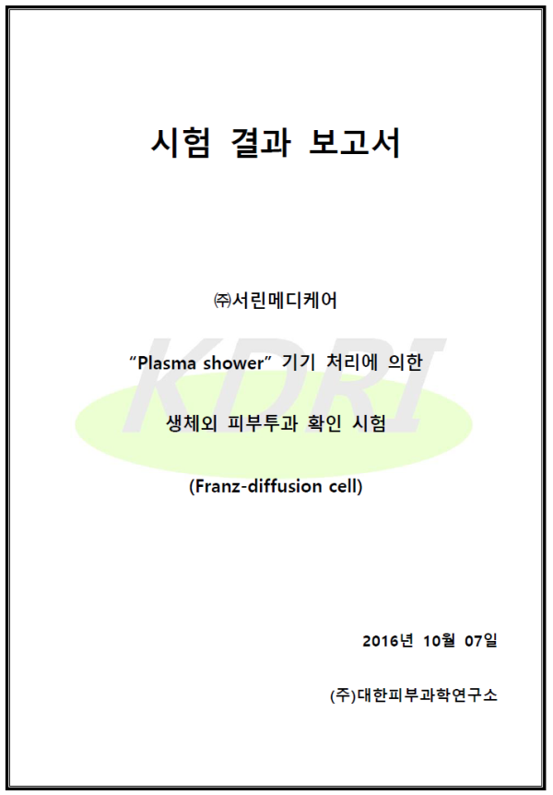
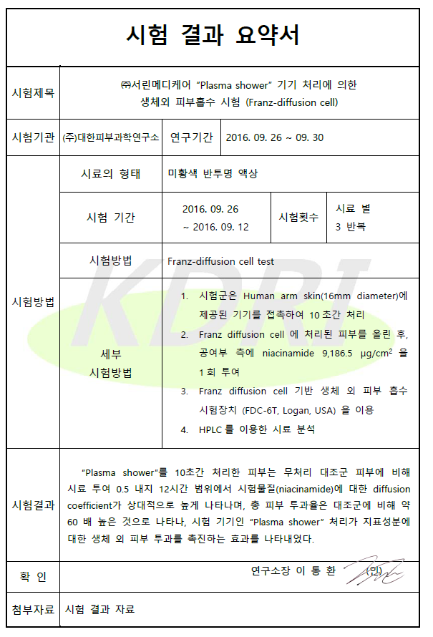
02_ Plasma shower
•Skin Absorption Test by Korea Institute for Skin and Clinical Sciences
(Franz-diffusion cell)
TDDS
Inducing amazing absorption by breaking the Cell Adhesion Molecules(CAMs) that connect the skin cell

Slide 14
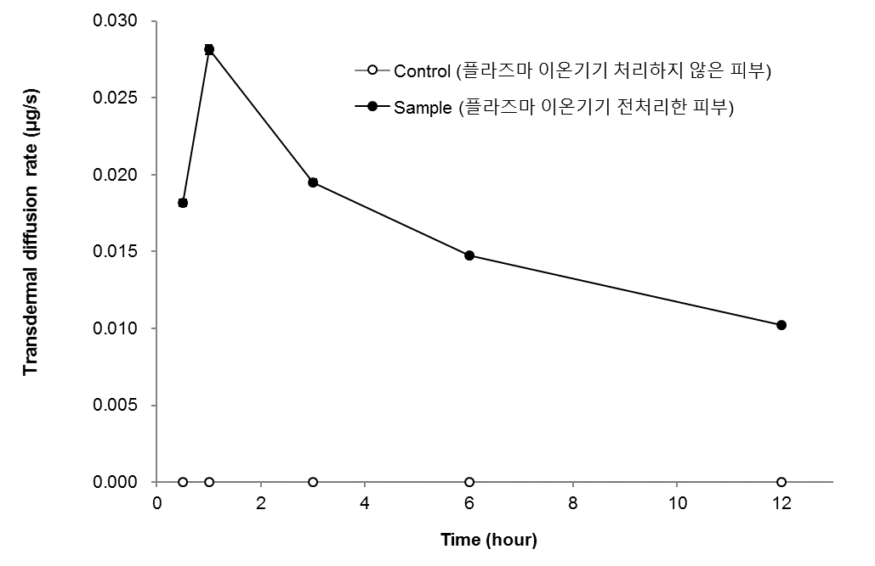
02_ Plasma shower
•Plasma Poration skin absorption test by Korea Institute
for Skin and Clinical Sciences (Franz-diffusion cell)
TDDS
Inducing amazing absorption by breaking the Cell Adhesion Molecules(CAMs) that connect the skin cell
Plasma Treated Skin
Rapid absorption up to an hour after dropping Vitamin B3 (Niacinamide)
(whitening cosmetic material)
Plasma Untreated Skin
No absorption ever after 12 hours of dropping

Slide 15
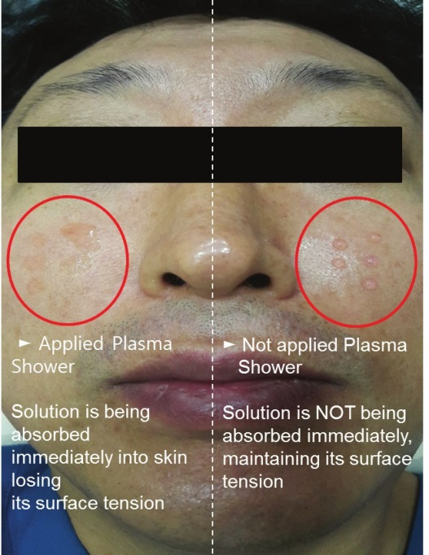
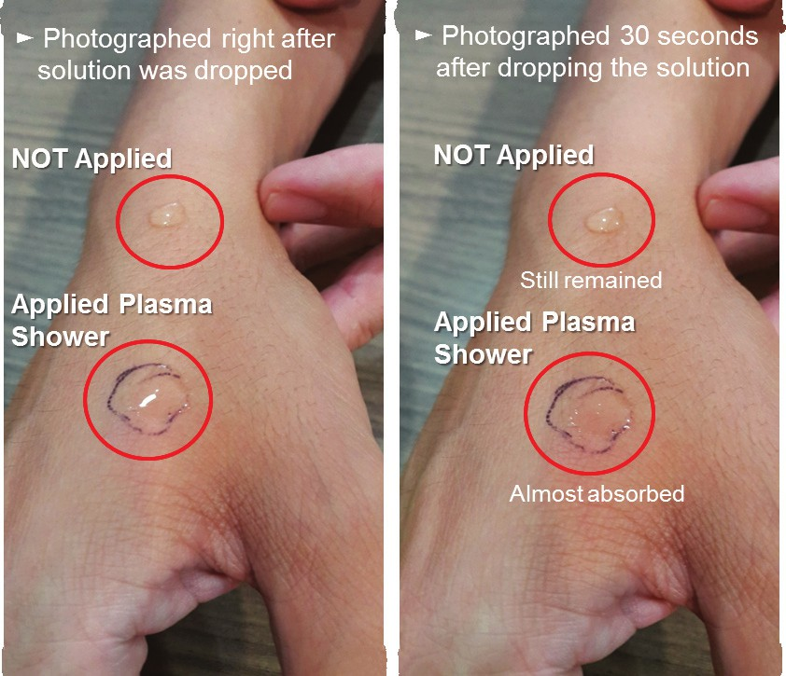
02_ Plasma shower
•Plasma Poration Skin Absorption Test
TDDS
Inducing amazing absorption by breaking the Cell Adhesion Molecules(CAMs) that connect the skin cell

Slide 16
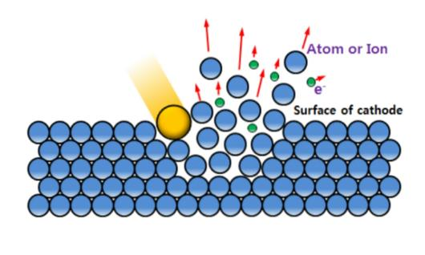
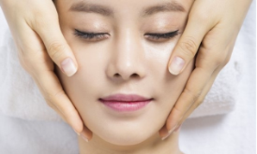
02_ Plasma shower
•Toning through rays produced by low-temp atmospheric plasma
Plasma
ion
Dead skin cell,
Foreign substance
Whiten the skin by removing foreign substance such as dead skin cell through sputtering phenomenon of ions
Toning Effect
Anti-pigmentation effect through suppressing melanin pigment and strengthening the absorption of anti-pigmentation cosmetics
Maximizing the effect by using the (whitening) solution on the opened up skin after treating with plasma
Improving skin elasticity by improving cell regeneration and blood circulation by making the skin potential uniform through plasma
No Pain!
No Downtime!

Slide 17
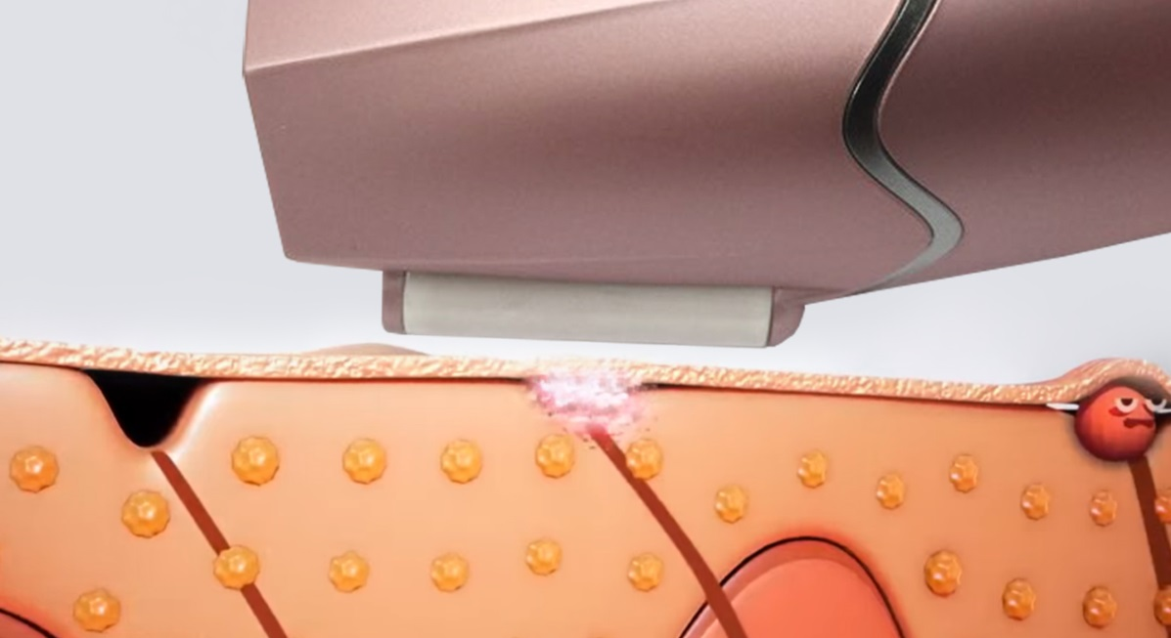
02_ Plasma shower
•Skin purification through sterilization
Sterilization
Virus, Germs, Acne Bacteria
Sterilize bacteria which cause various skin problems with powerful sterilization power
Powerful Sterilization Effect
Sterilizing acne germs and bacteria with effect similar to the
temperature of 3,500℃

Slide 18
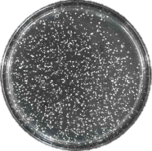
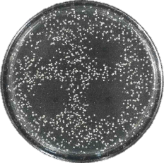
02_ Plasma shower
•P. Acnes removal experiment using plasma
Plasma Untreated
Plasma treated
1 sec
5 sec
Sterilization
Sterilize bacteria which cause various skin problems with powerful sterilization power
10 sec
15 sec
Treating plasma with 1 sec, 5 sec, 10 sec, 15 sec, significantly showed the sterilization effect compared to plasma untreated group
Mitigating skin trouble with sterilization function,
reconstruct skin tissue and vitalize skin

Slide 19
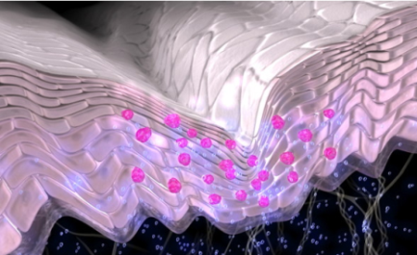
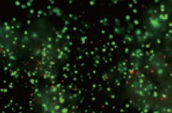
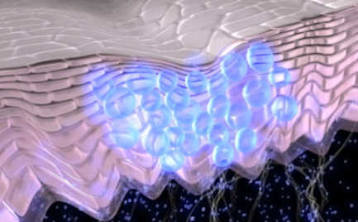
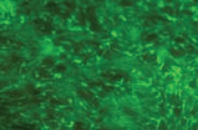
02_ Plasma shower
•Skin Reproduction through stimulation of collagen generation
Plasma Untreated
Skin Regeneration
Preventing skin aging by stimulating generation of collagen and fibroblasts
Plasma Treated (Collagen generation)
By stimulating fibroblasts, generating collagen
and reproducing elastin fibers

Slide 20
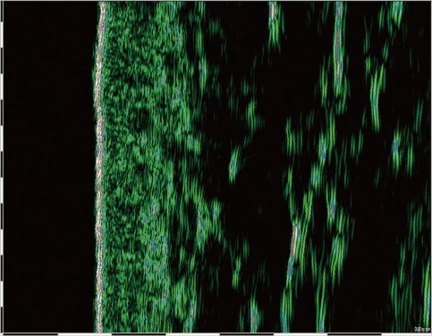
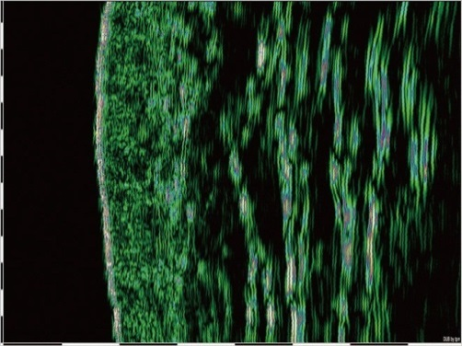
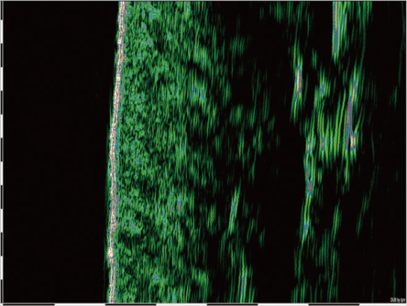
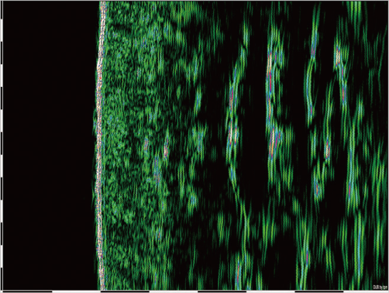
02_ Plasma shower
•Epidermis thickness difference after Plasma Poration
Before
After 4 weeks
Skin Regeneration
Preventing skin aging by stimulating generation of collagen and fibroblasts
Before
After 4 weeks
Skin tissue is
loose as if
emptied out
The tissue becomes tightly packed
Source Korea Institute for Skin and Clinical Sciences (Used DUB-Sin Scanner)
Due to effective skin regeneration, strengthen cell life, optimize cell regeneration cycle, reproduce cell and increase anti-aging effect

Slide 21
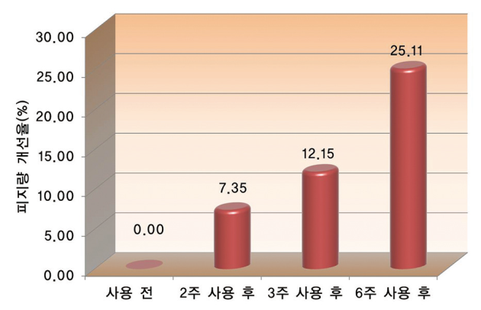
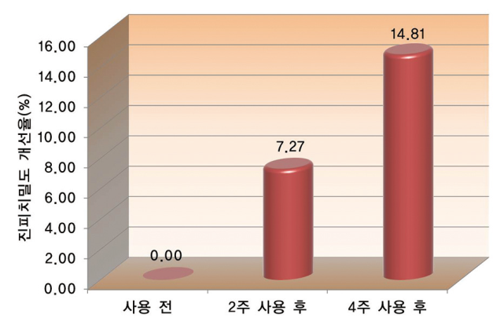
02_ Plasma shower
•Research on Plasma Poration by KISCS
(Korea Institute for Skin and Clinical Sciences)
•Research Title : Improvement on acnes and tightness of skin
• Research Period : 4 – 6 Weeks
• Research Group : 43 Adult Male/Female (20-50s)
• Research Result : Sebum Improvement 25.11%, Skin Tightness 14.81%
Skin Regeneration
Patient Satisfaction 100%
Preventing skin aging by stimulating generation of collagen and fibroblasts
Acne(sebum) Improvement (%)
Skin Tightness Improvement
Before Use After 2weeks After 3weeks After 4weeks
Before Use After 2weeks After 4weeks

Slide 22
How to
PLASMA SHOWER
the ways to Plasma Shower

Slide 23
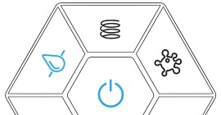
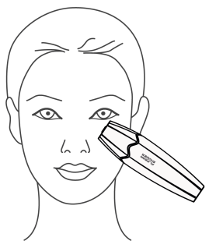
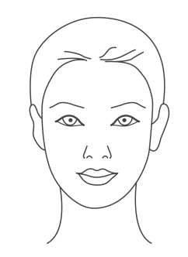
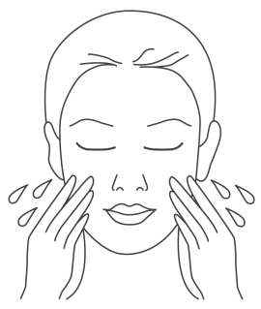
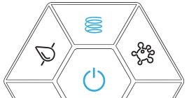
03_ How to Plasma shower
•Acne, Inflammation and Virus Skin Disease
or
Directions
Select appropriate mode
Apply on face by pressing the shot button 2-3 time on affected area
Increased effectiveness when used with appropriate solution and cream
•Effective acne treatment and pole tightening (see clinical results)
•Stopping bacteria from spreading through sterilization effect
Expected Effect

Slide 24
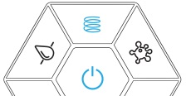
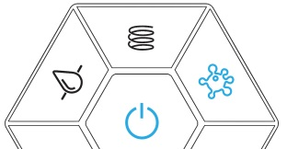
03_ How to Plasma shower
•Wrinkles, Skin Tightening, Pole Tightening, Scar Treatment, Skin Whitening
Directions
or
Apply on face by pressing the shot button 2-3 time on affected area
Increased effectiveness when used with appropriate solution and cream
Select the mode appropriate or use the Calming mode
•Has effect on improving crow’s feet, wrinkles and smile line
•Reconstructing collagen and elastin fiber
Expected Effect

Slide 25
03_ How to Plasma shower
•Facial Line, Transdermal Drug Delivery (TDDS)
Directions
Select Calming mode
Apply naturally in straight or curvy stroke
Increased effectiveness when used with appropriate solution and cream
•Cosmetic absorption rate is increased by more than 60 times compared to
plasma shower untreated (e.g. Absorb hyaluronic acid molecules that are comparatively bigger in size)
•Other effects include such as improving skin elasticity and skin whitening
Expected Effect

Slide 26
Treatment Data
the evidence of effectiveness

Slide 27
04_ Treatment Data
“ Test on the acne skin ”
'Plasma ShowerⓇ
Test on the acne skin
Test Name
Client
Seoulin Medicare Co. Ltd.
Test Institution
Korea Institute for Skin and Clinical Sciences
Test Period
2015.12.30 ~ 2016.03.09

Slide 28
04_ Treatment Data
Acne Level Score Change
Acne Level Score Improvement Rate (%)
Acne Level Score | 2 weeks | 3 weeks | 6 weeks
Improvement Rate(%) | 13.0 | 21.97 | 26.91

Slide 29
04_ Treatment Data
•User Feedback
•Skin Condition Examination After Use
·········
·········
·········
·········
·········
·········
·········
·········
············
100% Red and sensitive acne areas are soothed
100% Skin tone has become light and brighter
100% Excessive sebum secretion is reduced
100% Bumpy and roughness of skin is reduced and became smooth
100% Skin has become tighter and elasticity improved
100% Wide and sagging poles are tightened
100% Itchiness due to acne are reduced
100% Dead skin cells are removed and skin is exfoliated
95.2% Acne feels reduced

Slide 30
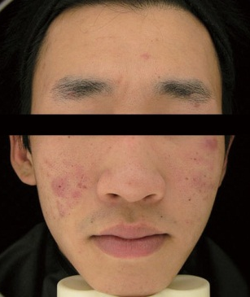
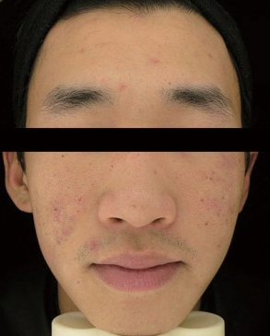
04_ Treatment Data
•Before and After photo by Korea Institute for Skin and Clinical Sciences of using Plasma Shower
Before
After

Slide 31
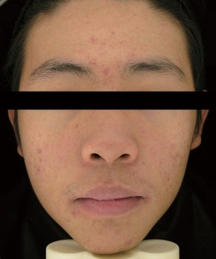
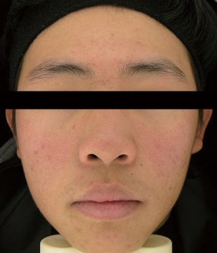
04_ Treatment Data
•Before and After photo by Korea Institute for Skin and Clinical Sciences of using Plasma Shower
Before
After

Slide 32
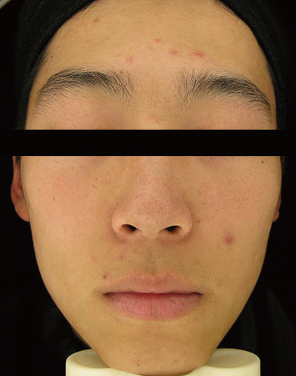
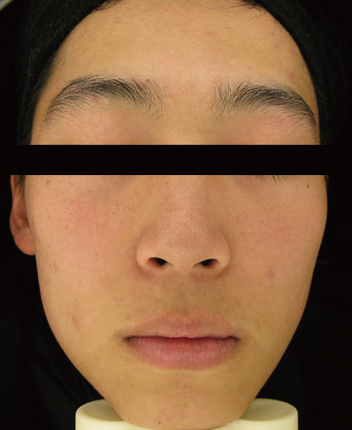
04_ Treatment Data
•Before and After photo by Korea Institute for Skin and Clinical Sciences of using Plasma Shower
Before
After

Slide 33
Clinical Data
the evidence of effectiveness

Slide 34
05_ Clinical Data
“ Test on dermis thickness improvement ”
'Plasma ShowerⓇ
Test on dermis thickness improvement
Test Name
Client
Seoulin Medicare Co. Ltd.
Test Institution
Korea Institute for Skin and Clinical Sciences
Test Period
2015.12.30 ~ 2016.03.09

Slide 35
05_ Clinical Data
Dermis thickness difference
Dermis thickness improvement rate (%)
Dermal Density | 2 weeks | 3 weeks
Improvement Rate(%) | 7.27 | 14.81

Slide 36
05_ Clinical Data
•User Feedback
86.4%
Easy and convenient use
95.5%
Overall usage experience
•Skin Condition Examination After Use
······
·········
·········
············
100% Skin has increased elasticity from inside.
95.5% Skin volume is increased.
95.5% Skin has healthy gloss.
90.9% Skin feels moisturized without dryness.

Slide 37
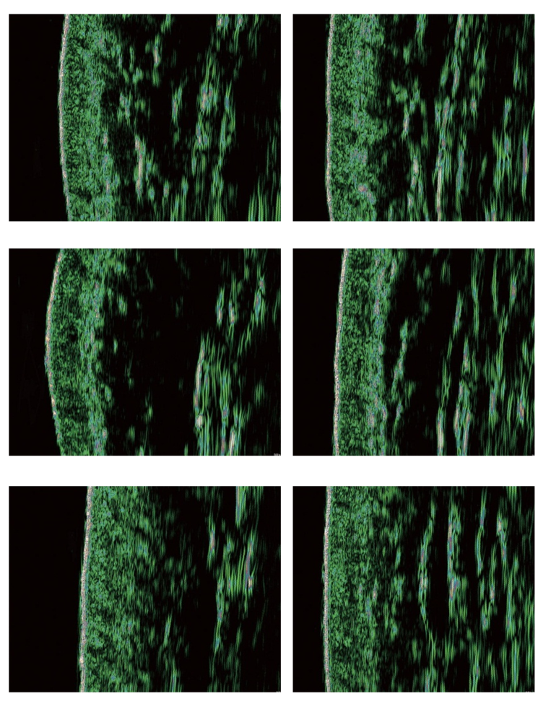
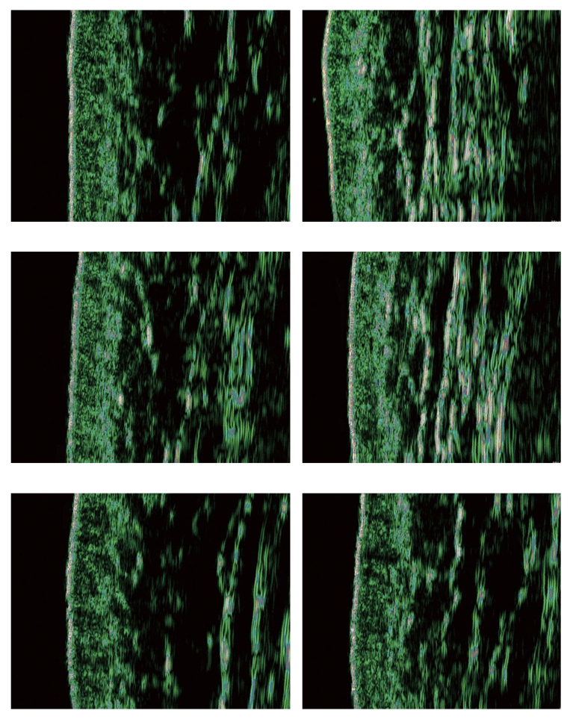
05_ Clinical Data
•Dermis thickness analysis photos using DUB-Sin Scanner (Korea Institute for Skin and Clinical Sciences)
Before
After 4 weeks
Before
After 4 weeks

Slide 38
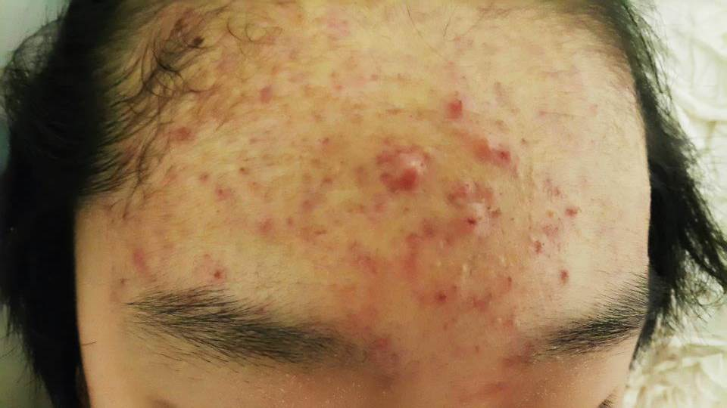
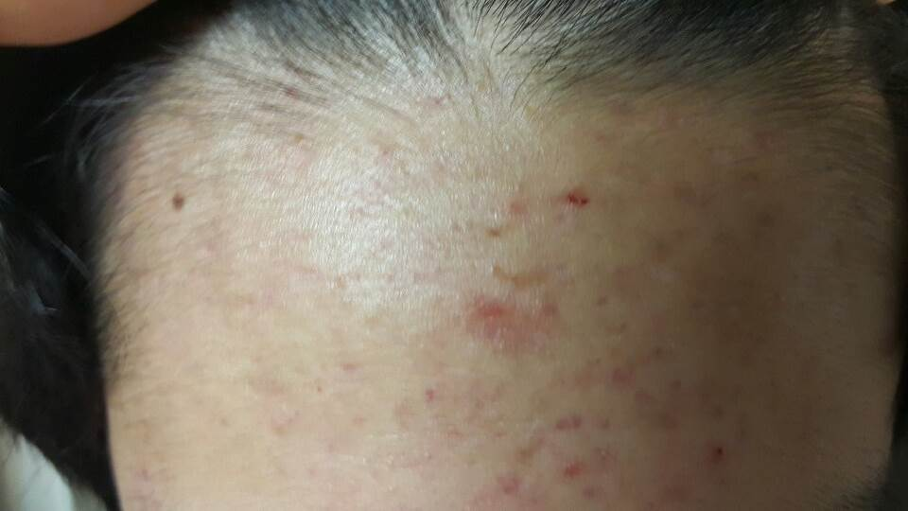
05_ Clinical Data
•Clinical results on skin improvement
Before
After 3 weeks

Slide 39
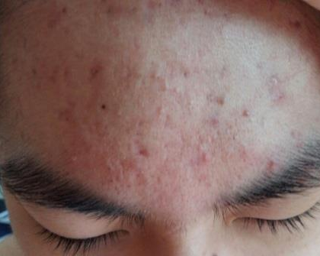
05_ Clinical Data
•Clinical results on skin improvement
Before
After 3 weeks

Slide 40
05_ Clinical Data
•Clinical results on skin improvement
Before
After 1 weeks

Slide 41
05_ Clinical Data
•Clinical results on skin improvement
Before
After 1 weeks

Slide 42
05_ Clinical Data
•Clinical results on skin improvement
Before
After 1 weeks

Slide 43
05_ Clinical Data
•Clinical results on skin improvement
Before
After
Before
After

Slide 44
05_ Clinical Data
•Ozone emission rate test
ppm
Institution | Product | Test Item | Operating Hour | Operation Mode | Test Result
Korea Conformity Laboratories (KCL) | Plasma Shower | Ozone emission rate | 1hour | MASSAGE (Hard) | Under o.oo5ppm
Testing ACNO Plasma Shower for an hour using Massage Mode, emission was safe with less than 5%(0.005ppm) of Standard Level(0.1ppm)

Slide 45
Thank you
4th floor, seoulin global center, 593-16, dongtangiheung-ro, hwaseong-si, gyeonggi-do, 18469, korea
Tel: +82 31 742 5319 Fax: +82 0504 981 5319 sales@seoulinmedicare.com www.seoulinmedicare.com

